Slide 1
AI powered Resume and Portfolio Builder for Students
CAPSTONE PROJECT
Presented By:
Student Name- ATHMI S SHETTY
College Name- Sahyadri college of Engineering and Management,Adyar,Mangaluru
Department- CSE(AIML)

Slide 2
OUTLINE
Problem Statement
Proposed System/Solution
System Development Approach
Algorithm & Deployment
Result
Conclusion
Future Scope
References

Slide 3
PROBLEM STATEMENT
Many students struggle to create professional and well-structured resumes due to lack of formatting knowledge, technical writing skills, and awareness of industry standards. Creating a resume manually is time-consuming and often results in poorly organized content. There is a need for an intelligent system that can automatically generate professional resumes based on user input.

Slide 4
PROPOSED SOLUTION
I developed an AI-powered Resume & Portfolio Builder that generates professional resumes based on user input. The system collects details such as education, skills, and experience through a Streamlit web interface and uses the Gemini Generative AI model to automatically create a well-formatted, industry-standard resume.
The solution ensures:
Proper formatting and structured sections
Professional language enhancement
Time efficiency
Easy accessibility for students

Slide 5
SYSTEM APPROACH
The system follows a structured approach to generate professional resumes using Generative AI:
User Input Collection
The user enters personal details, education, skills, experience, and projects through a Streamlit web interface.
Data Processing
The entered information is organized and formatted into a structured prompt.
AI Resume Generation
The structured prompt is sent to the Gemini Generative AI model, which generates a professionally formatted resume.
Output Display
The generated resume is displayed on the screen for the user to review and download.

Slide 6
ALGORITHM & DEPLOYMENT
Algorithm: AI Resume Generation System
Start
Display input form to the user
Collect user details (Name, Education, Skills, Experience, Projects)
Validate input fields
Create a structured prompt using the entered data
Send the prompt to the Gemini Generative AI model
Receive generated resume content
Display the formatted resume on the screen
End
.

Slide 7
DEPLOYMENT
Deployment Strategy
The application is developed using Python and Streamlit
Gemini API is integrated for AI-based resume generation
The application can be deployed using:
Streamlit Cloud
Local Server
GitHub + Streamlit deployment
Users can access the system through a web browser

Slide 8
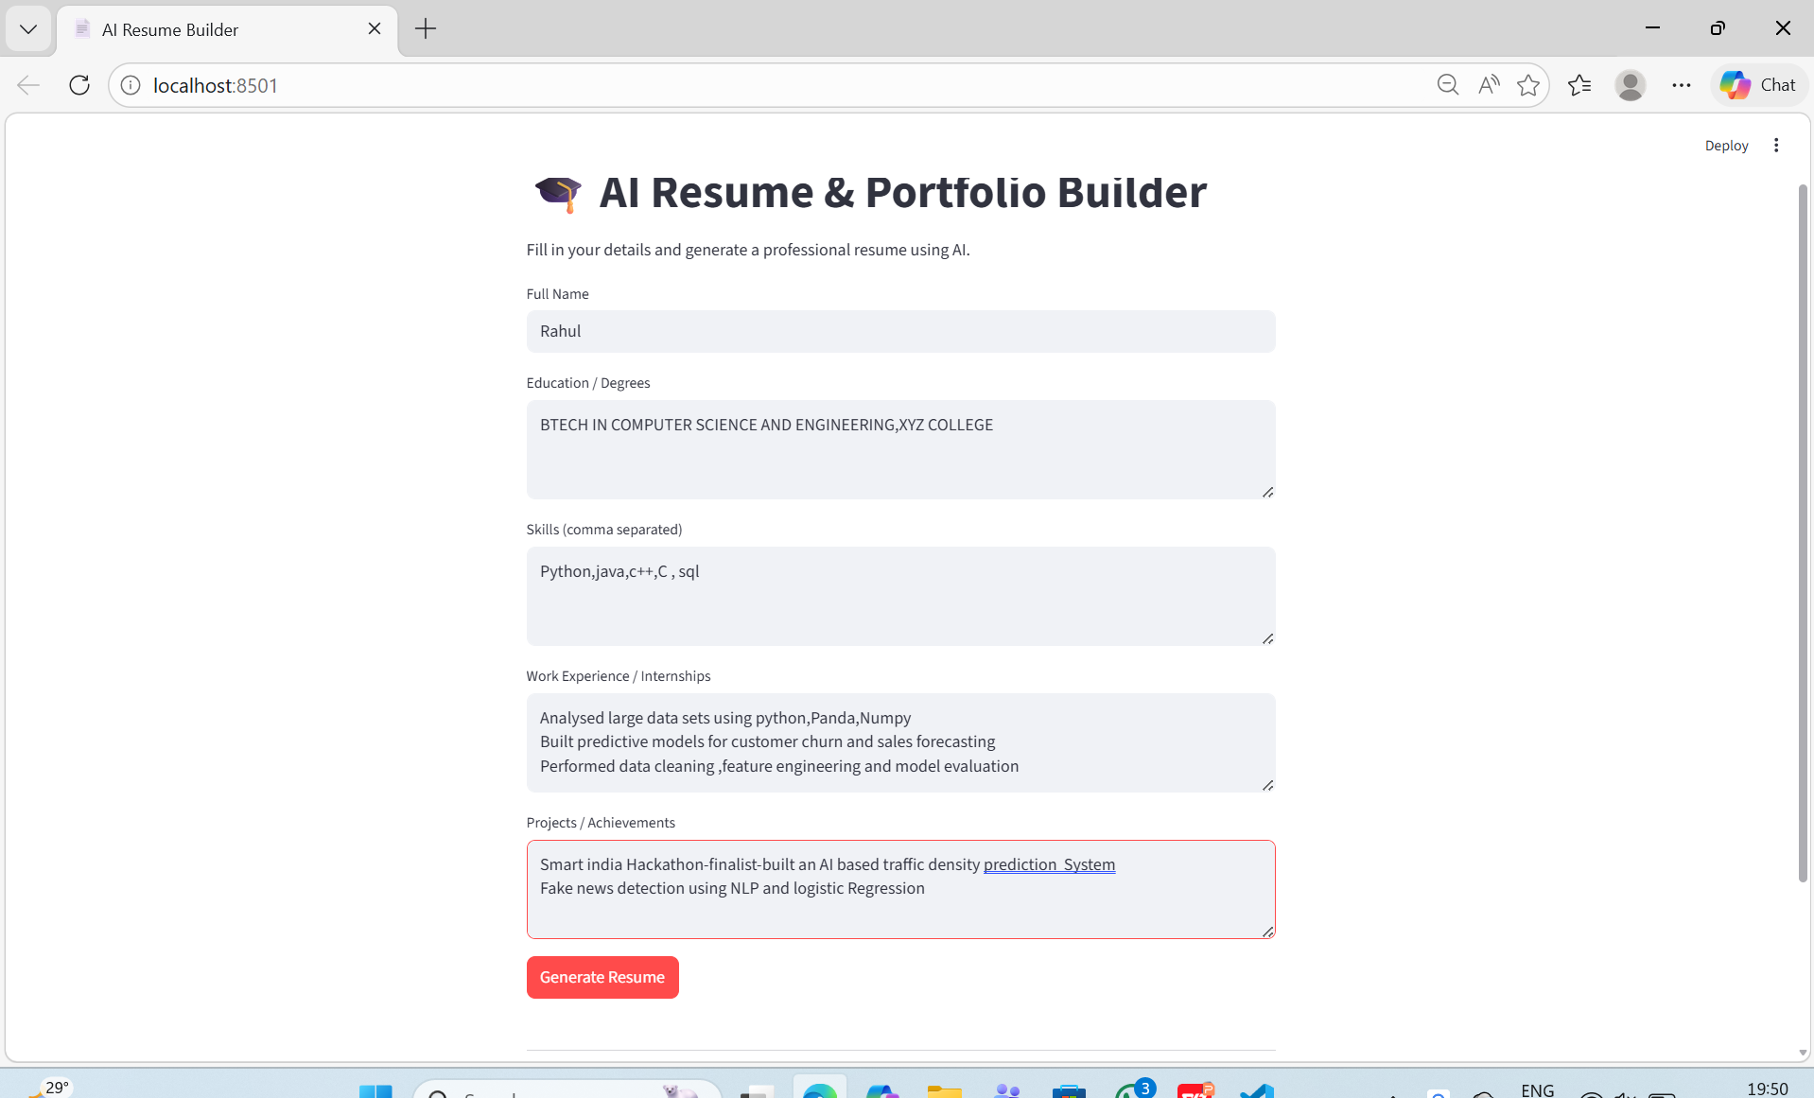
RESULT
The developed AI-powered Resume Builder successfully generates professional and well-structured resumes based on user input. The system collects details such as education, skills, experience, and projects, and produces an industry-standard formatted resume within seconds.
The application:
Successfully integrates Streamlit with Gemini API
Generates structured and professional resume content
Reduces manual effort and formatting errors
Provides quick and efficient resume creation
The output is displayed instantly on the web interface for user review.

Slide 9
CONCLUSION
The AI-Powered Resume & Portfolio Builder successfully automates the process of resume creation using Generative AI. The system reduces manual effort, improves formatting quality, and generates professional, industry-ready resumes within seconds. By integrating Streamlit with the Gemini API, the application provides a simple, efficient, and accessible solution for students to create high-quality resumes.

Slide 10
FUTURE SCOPE
Add PDF and DOCX download options
Provide multiple resume templates and themes
Implement ATS (Applicant Tracking System) optimization
Add grammar and skill enhancement suggestions
Enable portfolio website auto-generation
Store user data securely with login authentication
Deploy as a mobile-friendly web application
.

Slide 11
REFERENCES
Google Gemini API Documentation
Streamlit Official Documentation
Python Programming Language Documentation
Generative AI Concepts – OpenAI & Google AI Resources
Research articles on AI-based content generation

Slide 12
GITHUB LINK
Github Link :https://github.com/Athmi-S/batch7_aicte_skillsbuild_ATHMI-S-SHETTY.git

Slide 13
THANK YOU

